Slide 1


GIT
First steps
Maksym Oleshchuk
Senior Software Engineer
May 24, 2017

Slide 2
CONTENTS
1
What is it?
2
Why do I need that?
3
How can I work with it?
4
How to find what I did?
5
How to undo if something going wrong?
6
What to do after lecture?

Slide 3

What is GIT?

Slide 4

Git is …
Notes:
Git — розподілена система керування версіями файлів та спільної роботи.

Slide 5
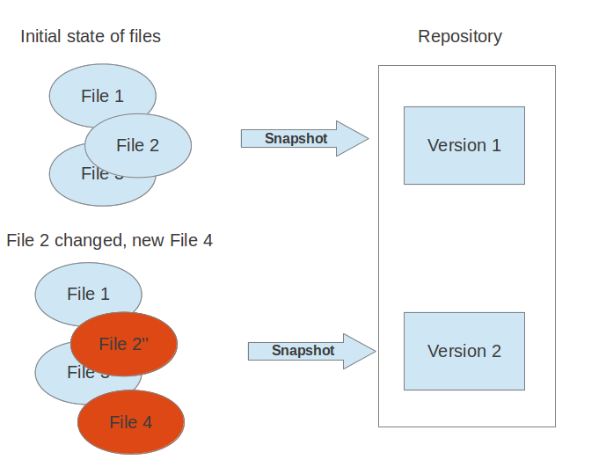
VCS is …
Notes:
A version control system (VCS) allows you to track the history of a collection of files. It supports creating different versions of this collection. Each version captures a snapshot of the files at a certain point in time and the VCS allows you to switch between these versions. These versions are stored in a specific place, typically called a repository.
You may, for example, revert the collection of files to a state from 2 days ago. Or you may switch between versions of your files for experimental features. The process of creating different versions (snapshots) in the repository is depicted in the following graphic. Please note that this picture fits primarily to Git. Other version control systems like Concurrent Versions System (CVS) don’t create snapshots of the files but store file deltas.

Slide 6
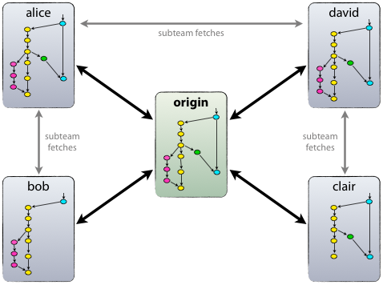
Distributed
Notes:
In a distributed version control system each user has a complete local copy of a repository on his individual computer. The user can copy an existing repository. This copying process is typically called cloning and the resulting repository can be referred to as a clone.
Every clone contains the full history of the collection of files and a cloned repository has the same functionality as the original repository.
Every repository can exchange versions of the files with other repositories by transporting these changes. This is typically done via a repository running on a server which is, unlike the local machine of a developer, always online. Typically, there is a central server for keeping a repository but each cloned repository is a full copy of this repository. The decision which of the copies is considered to be the central server repository is pure convention.

Slide 7
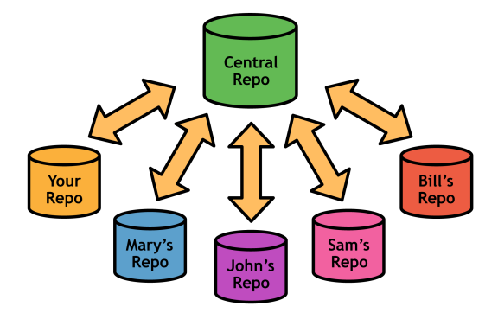
Localized and centralized
Notes:
A localized version control system keeps local copies of the files. This approach can be as simple as creating a manual copy of the relevant files.
A centralized version control system provides a server software component which stores and manages the different versions of the files. A developer can copy (checkout) a certain version from the central sever onto their individual computer.
Both approaches have the drawback that they have one single point of failure. In a localized version control systems it is the individual computer and in a centralized version control systems it is the server machine. Both system makes it also harder to work in parallel on different features.

Slide 8

Some history
Written by
Linus Torvalds
Notes:
Проект створив Лінус Торвальдс для управління розробкою ядра Linux, а сьогодні підтримується Джуніо Хамано (англ. Junio C. Hamano). Git є однією з найефективніших, надійних і високопродуктивних систем керування версіями, що надає гнучкі засоби нелінійної розробки, що базуються на відгалуженні і злитті гілок. Для забезпечення цілісності історії та стійкості до змін заднім числом використовуються криптографічні методи, також можлива прив'язка цифрових підписів розробників до тегів і комітів.

Slide 9
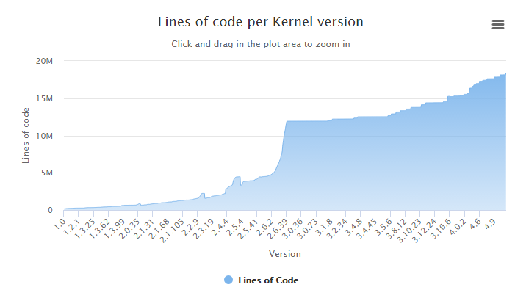
Some history

Slide 10

Why do I need GIT?

Slide 11
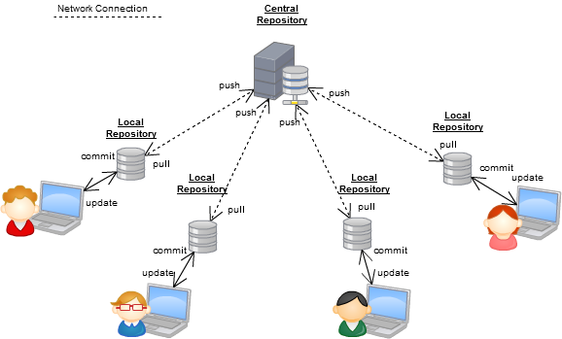
Distributed development

Slide 12
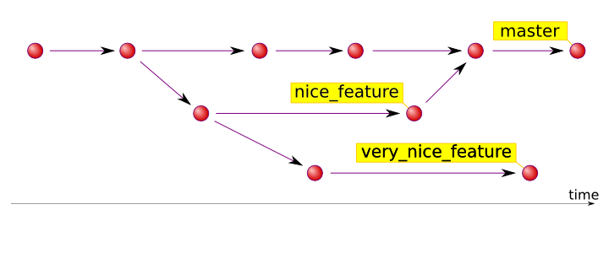
Branching
Notes:
A branch represents an independent line of development.
You can think of them as a way to request a brand new working directory, staging area, and project history. New commits are recorded in the history for the current branch.

Slide 13
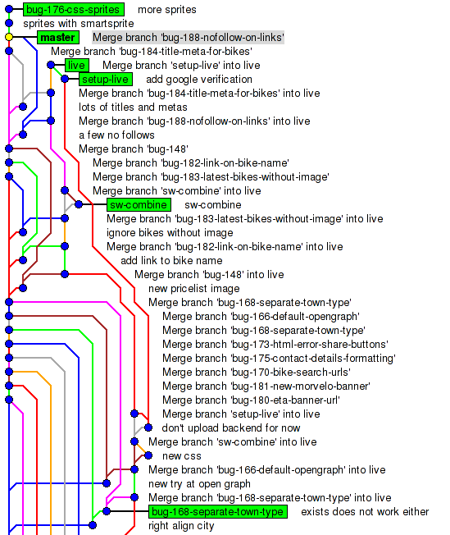
Branching in real life

Slide 14
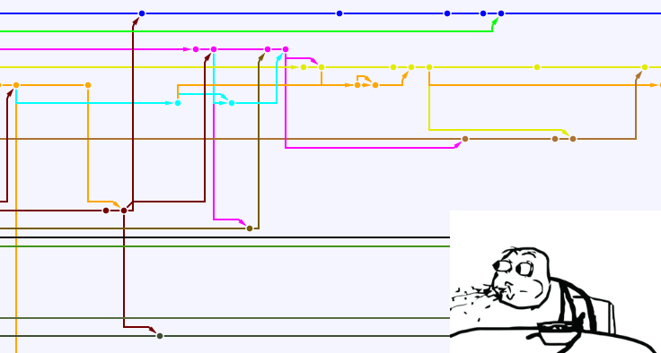
Branching in real life 2

Slide 15

GitHub support

Slide 16
Git vs other VCS
Decentralized
Branching
Local copy
Hard to delete, easy to recover
Not so easy to understand
Faster and smaller
Flexible, very TIMTOWTDI (There is more than one way to do it)
User-friendly

Slide 17
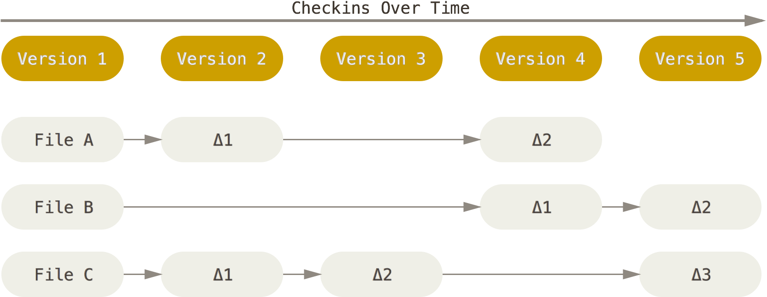
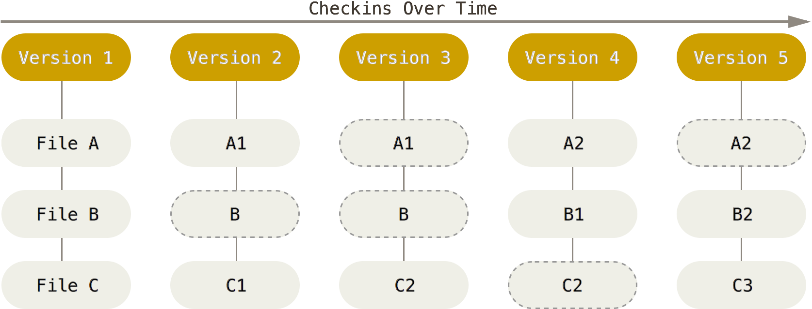
Git vs SVN

Slide 18
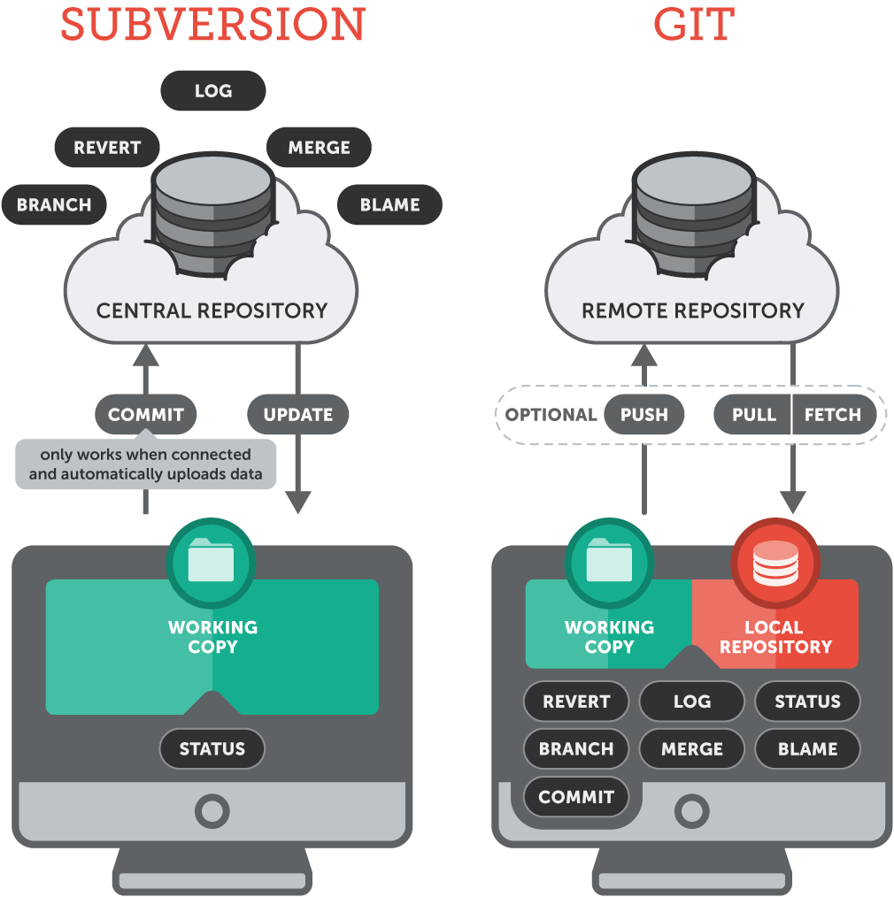
Git vs SVN

Slide 19










Git users

Slide 20

How to work with GIT?

Slide 21
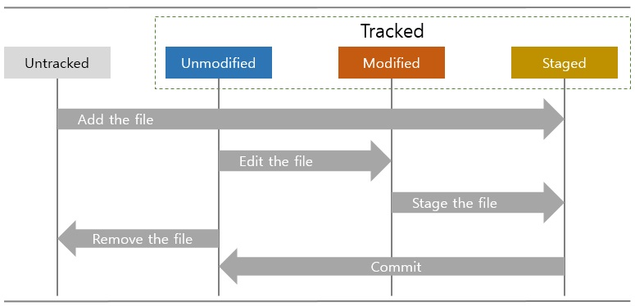
Git states
Notes:
GIT has three main states that your files can reside in: committed, modified, and staged.
Committed means that the data is safely stored in your local database.
Modified means that you have changed the file but have not committed it to your database yet.
Staged means that you have marked a modified file in its current version to go into your next commit snapshot.

Slide 22
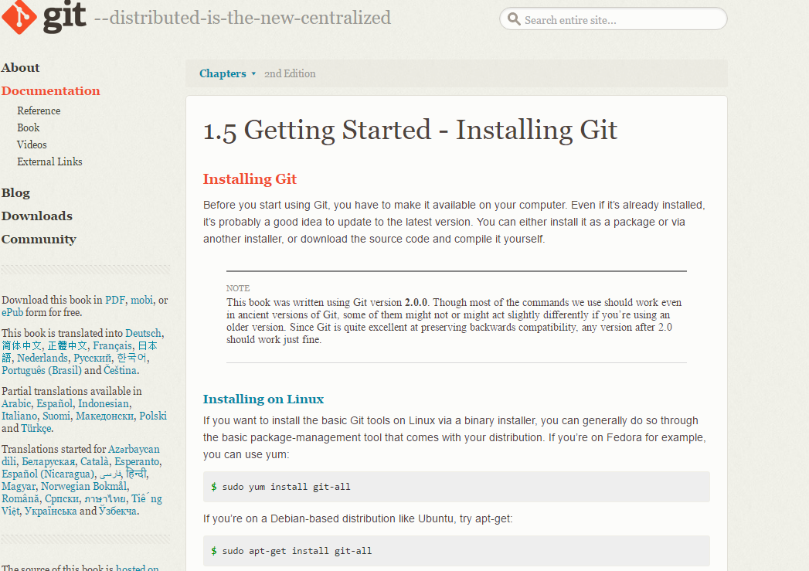
Git installing

Slide 23
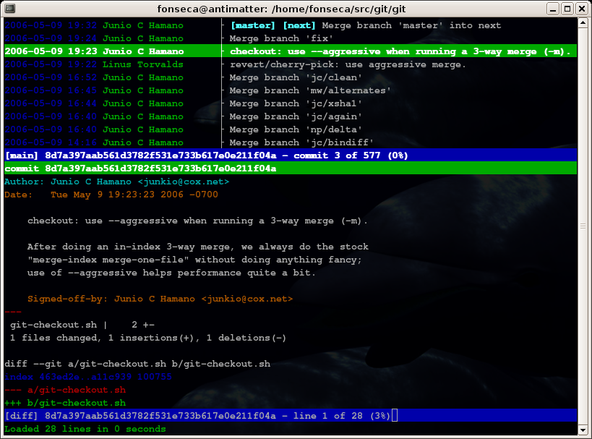
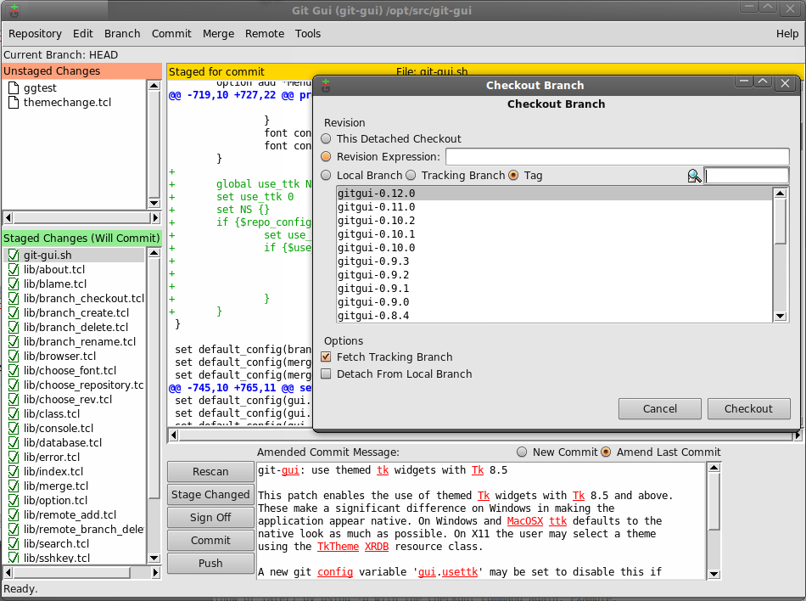
Git CLI vs GUI

Slide 24
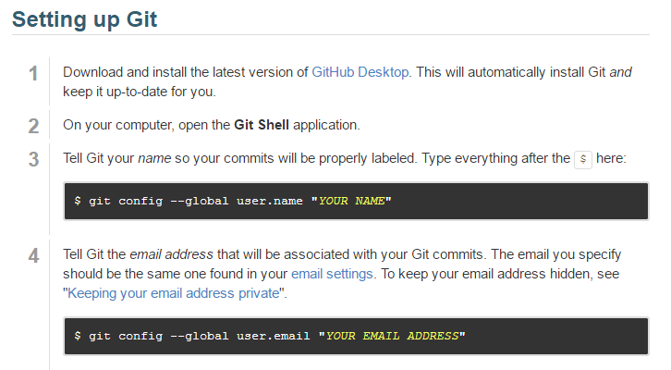
Git first setup

Slide 25
Git config example
Usage:
git config user.name <name>
--global user.email <email>
--system core.editor <editor>
--global --edit
Notes:
Config vars – just google.

Slide 26
GIT init
The git init command creates a new Git repository.
Usage:
git init (transform the current directory into a Git repository)
<directory> (create repository in the specified directory)

Slide 27
GIT clone
The git clone command copies an existing Git repository.
Usage:
git clone <repo>
<repo> <directory>

Slide 28
GIT add
The git add command adds a change in the working directory to the staging area.
Usage:
git add <file>
<directory>
<pattern> (*.txt, test-*.*)

Slide 29
GIT commit
The git commit command commits the staged snapshot to the project history.
Usage:
git commit
-m "<message>"
-a
-am “<message>”

Slide 30
GIT log message
Canonical format is to summarize the entire commit on the first line in less than 50 characters, leave a blank line, then a detailed explanation of what’s been changed.
Example:
Change the message displayed by hello.py
- Update the sayHello() function to output the user's name
- Change the sayGoodbye() function to a friendlier message

Slide 31
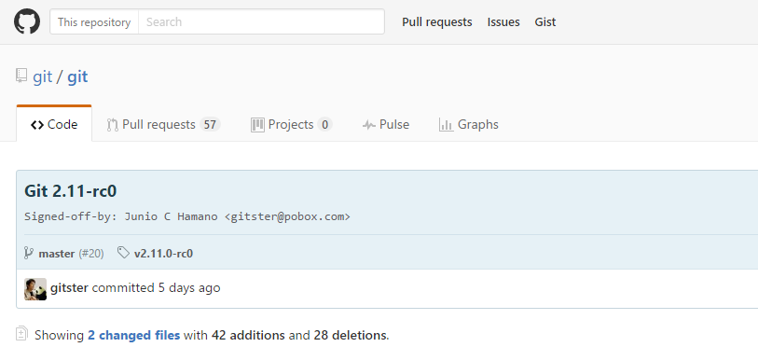
GIT log message

Slide 32
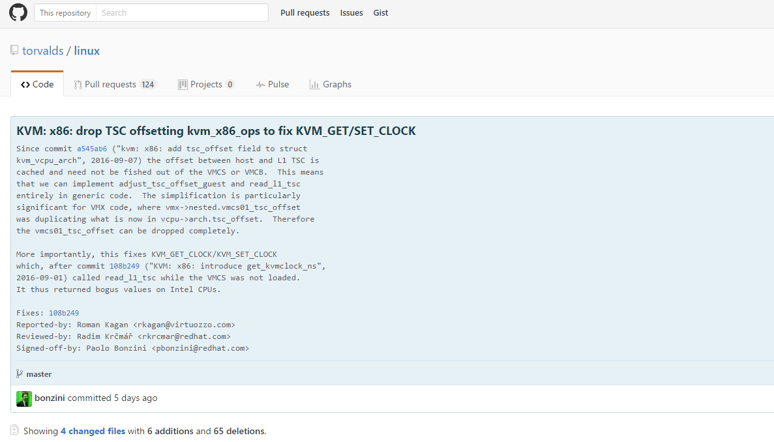
GIT log message

Slide 33
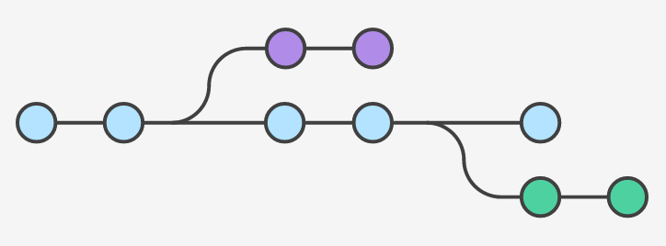
GIT branching
Notes:
PITSTOP!!!!
PRACTICE!!!!

Slide 34
GIT branch
A branch represents an independent line of development.
New commits are recorded in the history for the current branch.
Usage:
git branch (list all your branches)
<branch> (create a new branch without check out)
-d (safe delete)
-D (force delete)
-m (rename)

Slide 35
GIT checkout
The git checkout command lets you navigate between the branches created by git branch. Checking out a branch updates the files in the working directory to match the version stored in that branch
Usage:
git checkout <branch> (check out the specified branch)
-b <new branch> (new branch + check out)
-b <new-branch> <existing-branch>

Slide 36
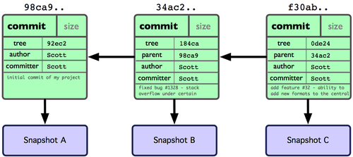
GIT references

Slide 37
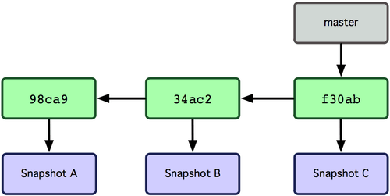
GIT references

Slide 38
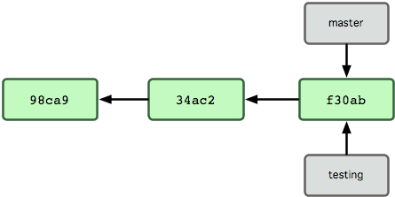
GIT references

Slide 39
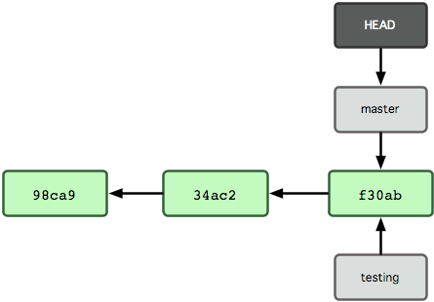
GIT references

Slide 40
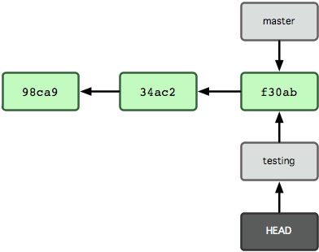
GIT references

Slide 41
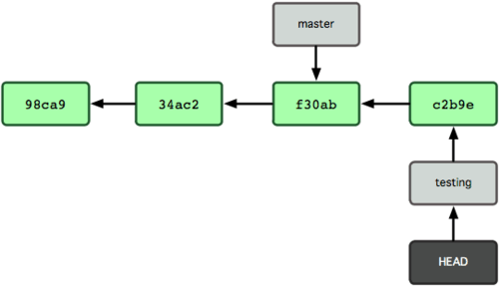
GIT references

Slide 42
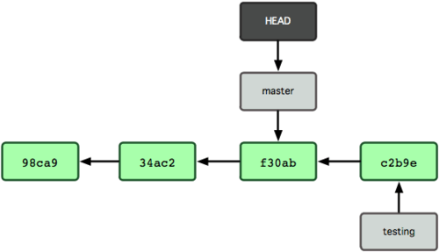
GIT references

Slide 43
GIT merge
Merge the specified branch into the current branch.
Usage:
git merge <branch> (merge the specified branch into the current branch)

Slide 44
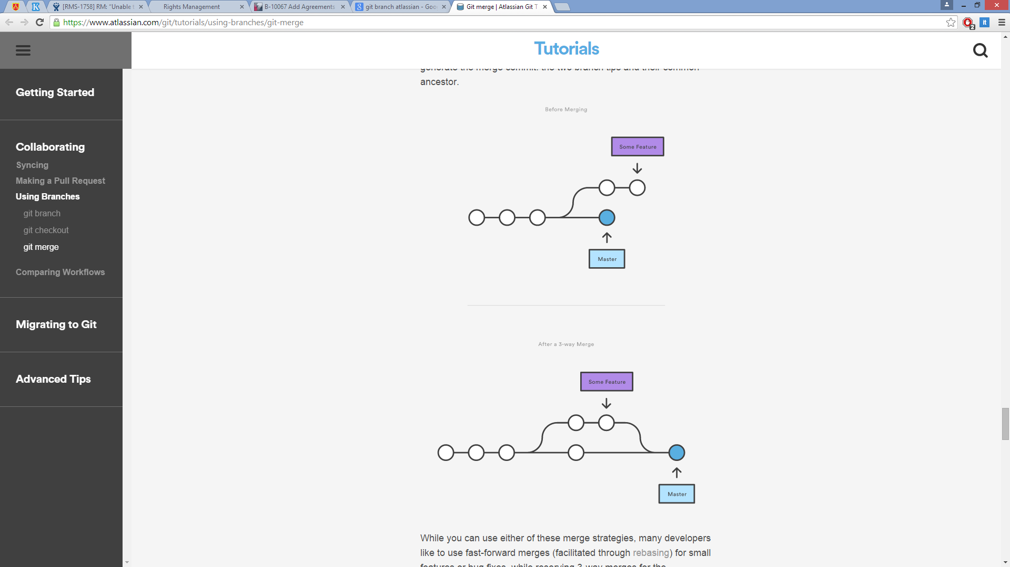
GIT merge

Slide 45
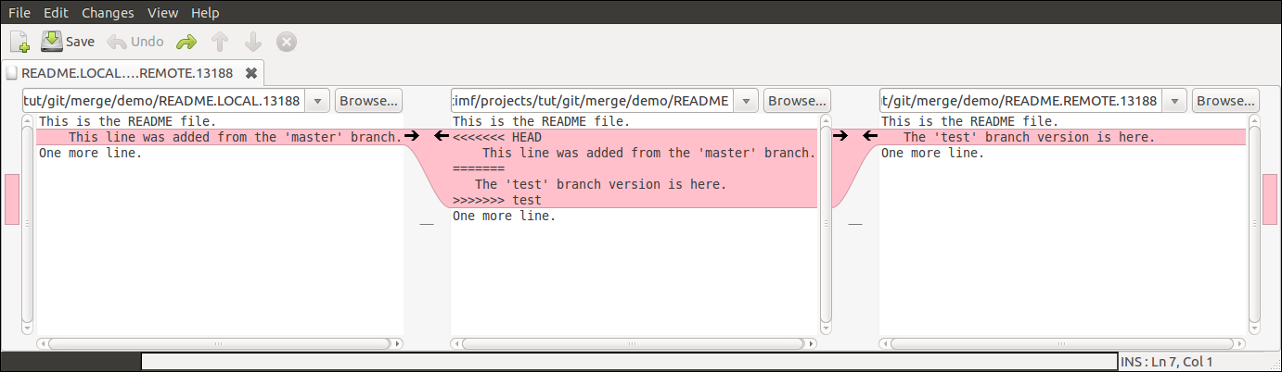
GIT conflict resolving
Notes:
STOP

Slide 46
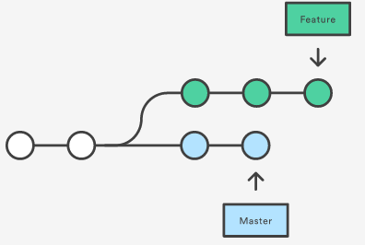
GIT rebase vs merge
Both of these commands are designed to integrate changes from one branch into another branch—they just do it in very different ways.

Slide 47
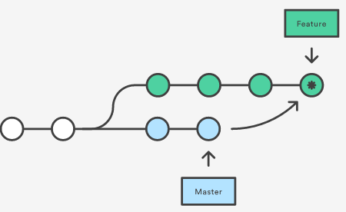
GIT merge
git checkout feature
git merge master

Slide 48
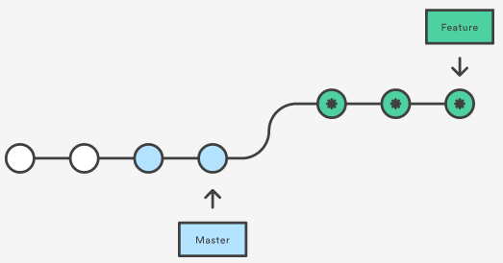
GIT rebase
git checkout feature
git rebase master
Notes:
The golden rule of rebasing
Never use it on public branches.

Slide 49
Merging diff Rebasing
Notes:
What is better? Why?
When will you use merge? When rebase
Atlassian…team

Slide 50
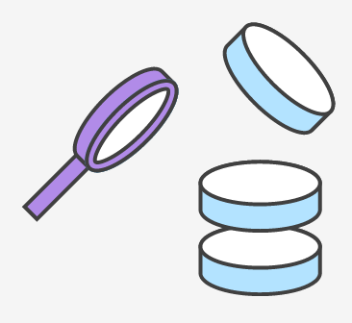
What I did?

Slide 51
GIT status
# On branch master
# Changes to be committed:
# (use "git reset HEAD <file>..." to unstage)
#
# modified: 1.txt
#
# Changes not staged for commit:
# (use "git add <file>..." to update what will be committed)
# (use "git checkout -- <file>..." to discard changes)
#
# modified: 2.txt
#
# Untracked files:
# (use "git add <file>..." to include in what will be committed)
#
# 3.txt

Slide 52
GIT advanced log
The git log command displays committed snapshots. While git status lets you inspect the working directory and the staging area, git log only operates on the committed history.
Usage:
git log (show all logs)
-n <limit>
--oneline
--stat
--author="<pattern>" or --grep=”<pattern>”
--graph --decorate --oneline

Slide 53

How to undo?

Slide 54
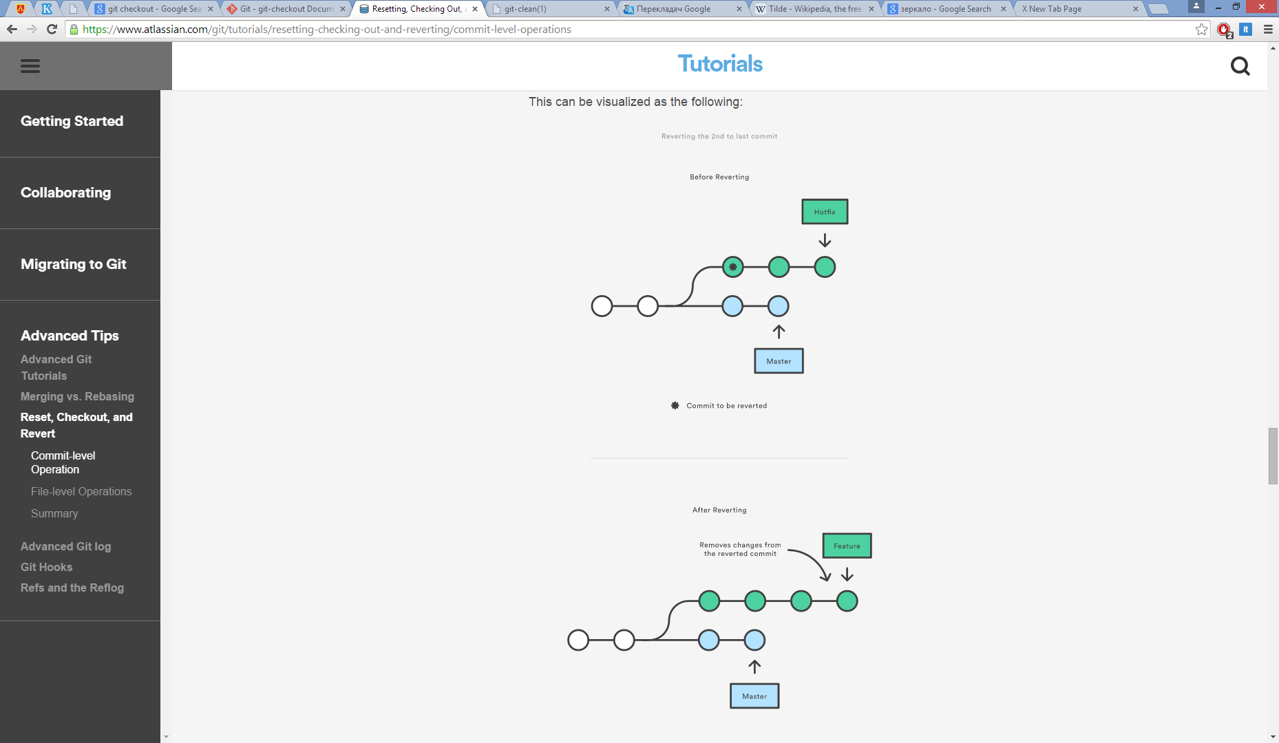
Revert
git checkout hotfix
git revert HEAD~2

Slide 55

Revert
public void newMethod() {
}
public void deletedMethod() {
}
public void newMethod() {
}
public void deletedMethod() {
}

Slide 56
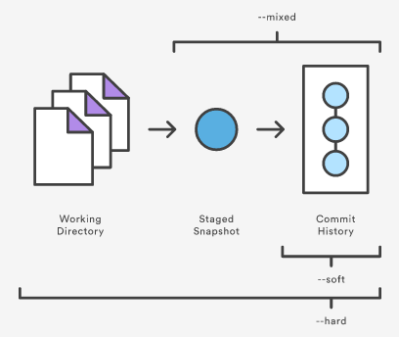
Reset
--soft – The staged snapshot and working directory are not altered in any way.
--mixed – The staged snapshot is updated to match the specified commit, but the working directory is not affected. This is the default option.
--hard – The staged snapshot and the working directory are both updated to match the specified commit.

Slide 57

What next?

Slide 58
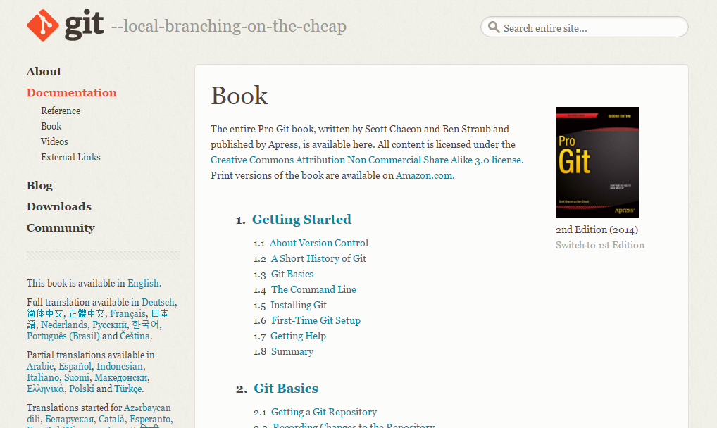
What to do after lecture 1
Notes:
https://git-scm.com/book/en/v2

Slide 59
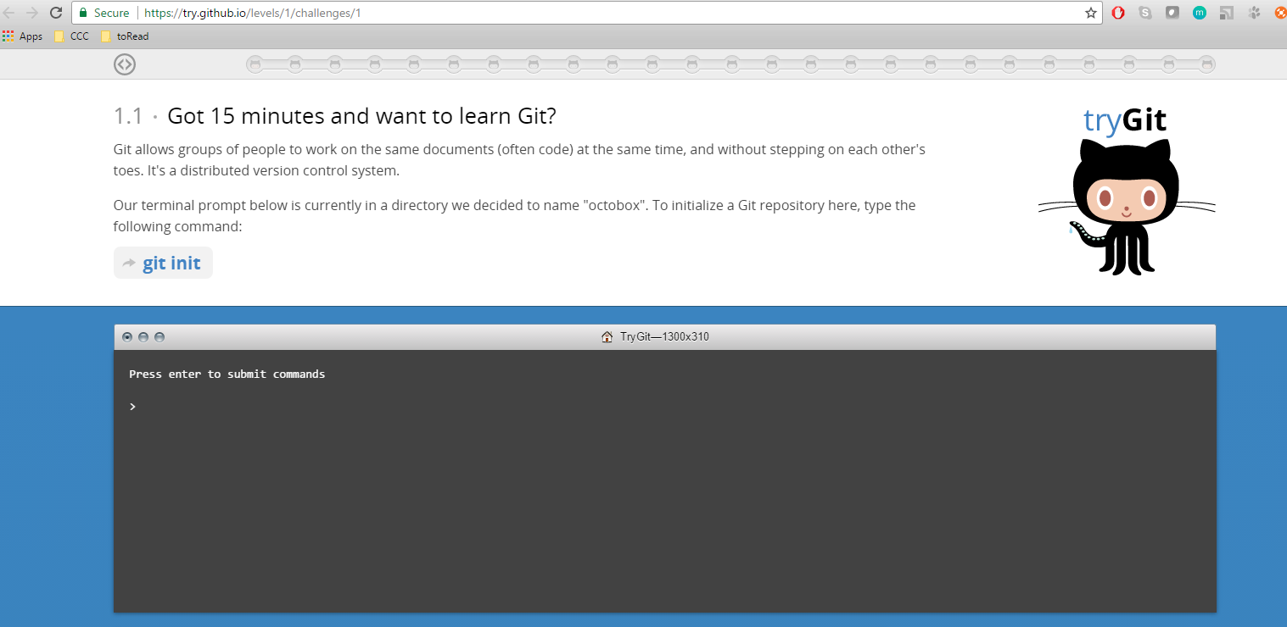
What to do after lecture 2
Notes:
https://try.github.io/levels/1/challenges/1

Slide 60
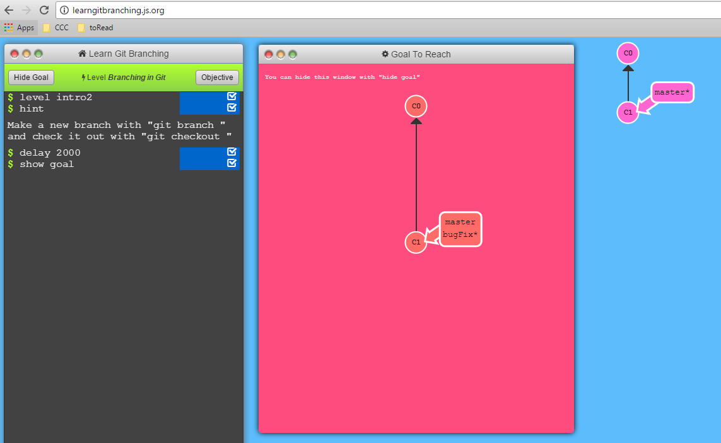
What to do after lecture 3
Notes:
http://learngitbranching.js.org/

Slide 61
QUESTIONS

